Slide 1
Tech Talk
The Oxford Nanopore Technology

Slide 2
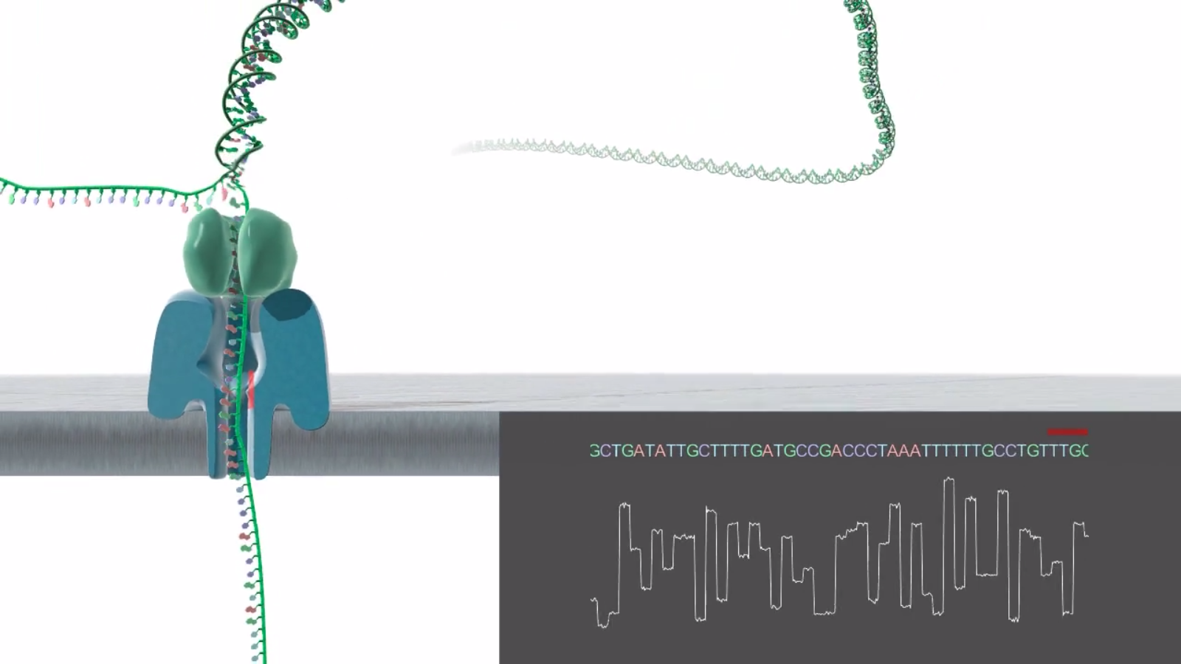
How it works..
Nanopore biosensor
Nanopore embedded in membrane
Voltage change by passing molecules

Slide 3
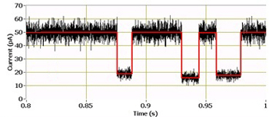
Type of data
Electrical signals
Each specific nucleotide results in a unique voltage pattern
Convert electrical signal
to nucleotide sequence
AGGCTTGGACCTTGACGTACGTA

Slide 4
Pro’s and Con’s
Read length (10kb)
test1

